Slide 1

What is Stereopsis?
The process in visual perception that leads to the sensation of depth due to the slightly different perspectives that our two eyes have of the world.
“Binocular Disparity”
Based on the separation of our eyes by other facial features

Slide 2
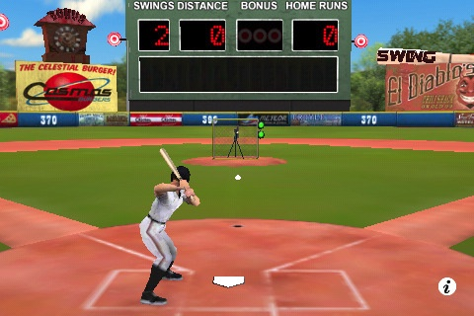
Depth Perception with Stereo Vision

Slide 3


Typical Binocular Stereo Vision
Batter must determine the location of the baseball in space…How do we do this?
Retinae

Slide 4
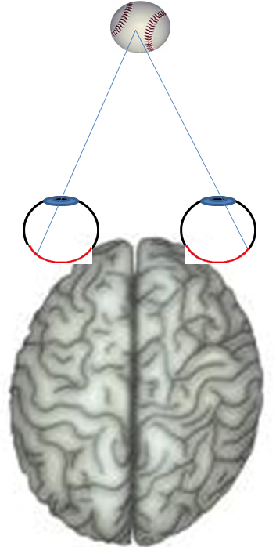
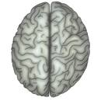


Photoreceptors in each eye perceive the image of the ball.
The image falls on a certain portion of each retina where it is transformed into an electrical signal by retinal ganglion cells.

Slide 5
The visual input is passed from each retina to the brain via neurons that make up the optic nerve.
So far the visual input from each retina is kept separate.
The primary destination of visual input is the Occipital lobe, located in the back of the brain.
Occipital Lobe

Slide 6
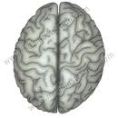

Biocular Neurons are found in the Occipital lobe.
Retinal inputs
Binocular neuron
These neurons receive axonal connections from both retinae.
The amount of difference between where the image fell on each retina is compared by the binocular neuron (i.e. computation of “degrees of disparity”).
X + Y - Z² = Degrees of disparity???

Slide 7
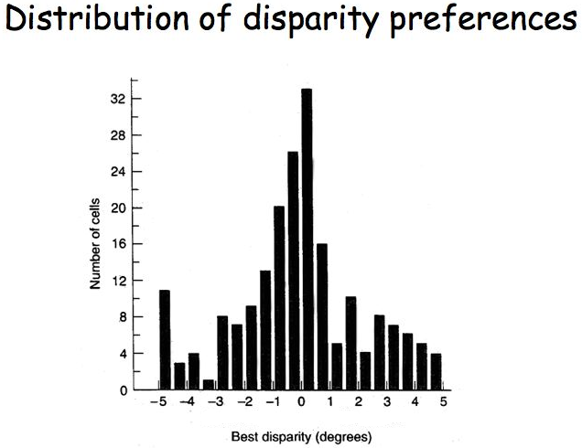
Binocular neurons in the Occipital lobe are tuned to specific degrees of disparity between retinal inputs.
  Some fire action potentials when the baseball is far away
  Some fire action potentials when the ball is close
“Far” binocular neurons
“Near” binocular neurons

Slide 8
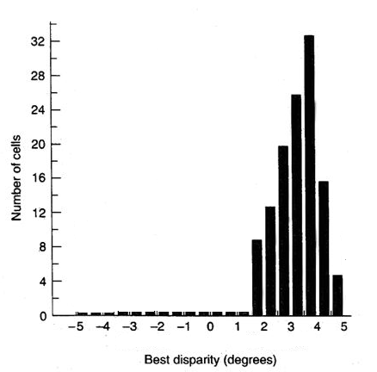
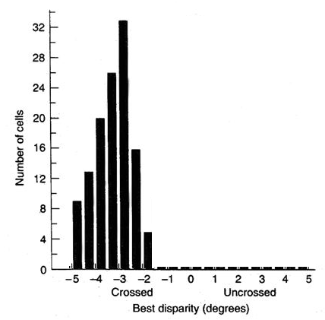
Pitch first thrown = ball is far from batter
More near binocular neurons fire!
Ball reaches home plate = is near to batter
More far binocular neurons fire!

Slide 9
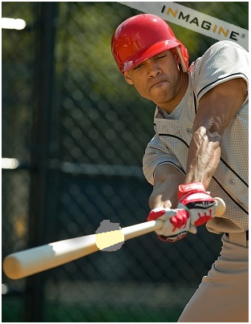


Stereoscopic vision relies on our ability to see with and coordinate both our eyes!
HOMERUN!!!

Slide 10
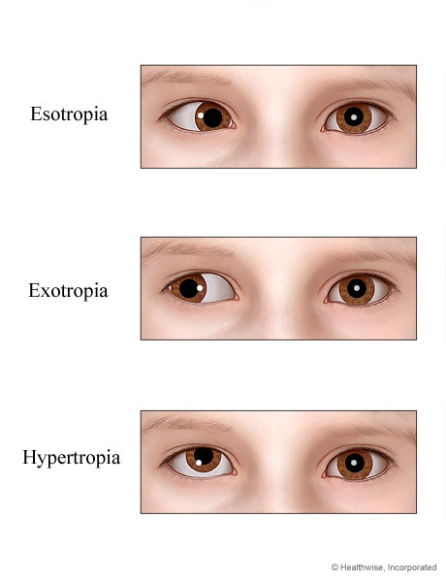
What Happens with Amblyopia?
Developmental disorder that degrades spatial vision and stereopsis
Lacking transmission of the visual image from the retina to the brain
Commonly known as “Lazy-eye”

Slide 11
When judging the depth of a baseball…
Retinal inputs
Retinal input only from one eye.
Binocular neuron
No depth perception from stereopsis…
Must rely on monocular cues to perceive depth!
Cannot determine
binocular disparity

Slide 12
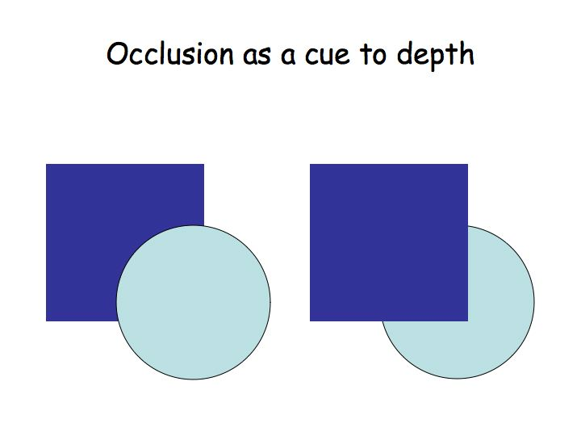
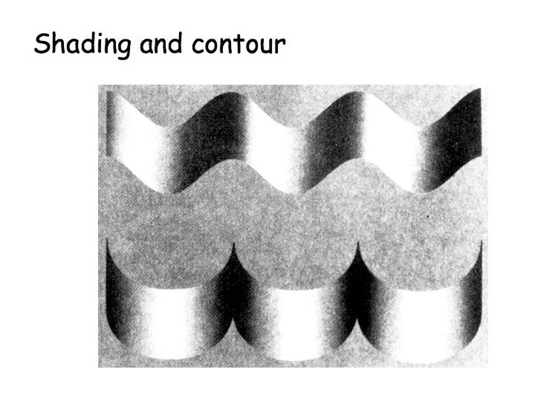
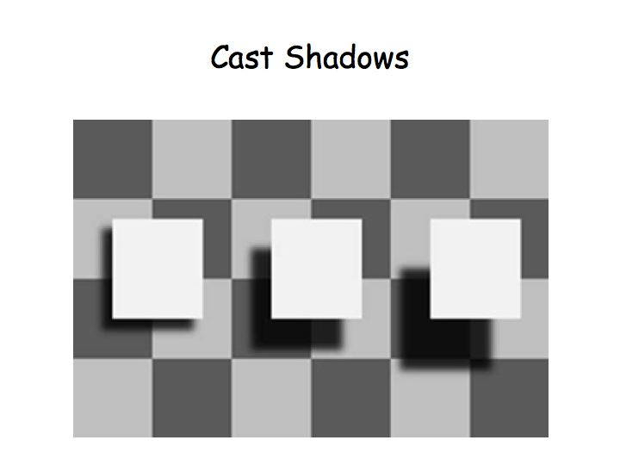
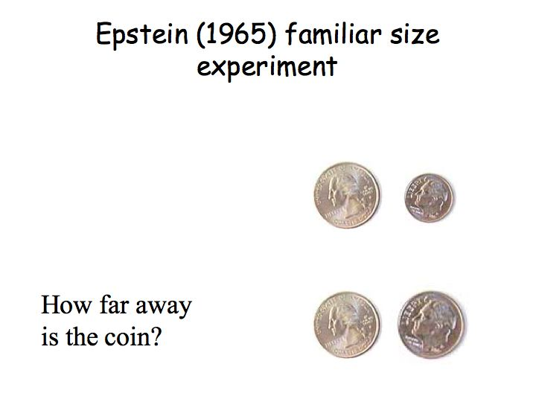
Monocular Depth Perception

